Slide 1
WLCOME ! እንኳን በደህና መጣችሁ! WEBINAR!

Slide 2
State of Electronic Transaction in Ethiopia
To manage the current Economy need ICT take us a reforming tool
Digital Transformation strategy was developed by MinT – in the way for approval (send to ministers office)
The document It identify and incorporate 4 important pillars:
Infrastructure
Power (Creating possible environment)
Applications (E-commerce, Fin Tech …),
Ecosystem (Finance, Human development, Policy & legal framework- Electronic transaction proclamation- approved, Personal data protection proclamation)

Slide 3
State of Electronic Transaction in Ethiopia
buying good and service online and paying your bills via your devices is not a luxury any more.
A 'Electronic Transaction' regulation that provides a legal framework for Electronic Commerce and other related aspects including e-receipts is on the final approval process.
The long awaited Payment instrument Issuers directives that was expected to open the mobile money and fintech space for non banks and MFIs is issued now.

Slide 4
Government eagerness and readiness to push for Digital activities in Ethiopia at it's pick
Payment System Operator Directive - Draft
Payment Aggregators,
Online payment processors,
non-bank automated teller machines (ATM),
payment switch operators,
PoS Operators and m-PoS operators

Slide 5
E-Commerce
E-Commerce –the sale or purchase of goods or services, whether between business, households, individuals or private organizations, through electronic transactions conducted via the internet or other computer –mediated (online communication networks).
Nature of Participants
Businesses
Consumers
Government
Nature of goods Sold
Physical goods
Digital Goods
Services

Slide 6
E-Commerce- Nature of Participant

Slide 7
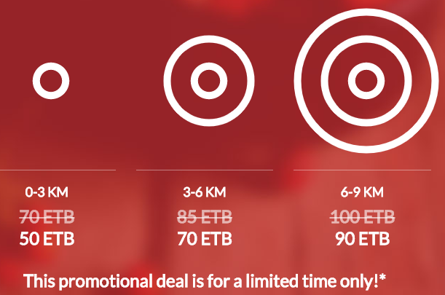
E-Commerce company in Ethiopia
Deliver Addis is a premier food delivery service startup in Ethiopia also now delivers Drinks, Flowers and as well groceries. Deliver Addis works with more than 70 restaurants in Addis Abeba. https://deliveraddis.com/

Slide 8
S.N | E-Commerce | Web | Pmt Getway | Delivery Price | Remark
1 | Deliver Addis | https://deliveraddis.com/ | CBE, Nib, Zemen and Amole | 50-90/km
2 | Zmall |  |  | 50 +10/km
3 | Asbeza Delivery | Aspeza.net | Paypal | 96birrND & 160 same day | Up to 100birr
4 | HellooMarket |  | Hellocash/bell cash/8420 |  | accessories
5 | Addis Mercato |  | CBE Birr, Mpesa, PayPal, Visa/MasterCard. |  | end-to-end e-commerce
6 | Mercato Online |  |  |  | 5km radius Electronic
7 | Fetan Mart |  |  |  | van, motorcycles
8 | Brundo |  | CBE Birr and helloCash through Yenepay yenepay, Enqupay, paypay, master,visa |  | mediator handel delivery
9 | Deamat |  | Amole, M-birr and Hello Cash |  | Agricultural prod

Slide 9
E-Commerce company in Ethiopia
Qefira
Sheger.Net (mekina, Betoch, Shager.net)
FloMart ( Flobiller )

Slide 10
Getway Operator
6 largest Micro Finance Institutions
ACSI, DECSI, OCSSCO, OMO and ADCSI.
Donation Fund collection getaway
http://degafi.com/
https://www.agarfund.com/
https://www.yenepay.com/
https://community.yenepay.com/
https://www.belcash.com/
Flowcash
Ethiopay

Slide 11
S.N | Getaway | Web | Owner | Tarif Price | Customer base | Investers
1 | CBE Birr | www. Cbe.com |  |  | 3.5Million
2 | M Birr |  | MOSS Technology |  | 1.5Million | FinnFund, EuropeanIB, DEG KfW #818
3 | Bel Cash /Hellocash | https://www.belcash.com | Zemedeneh
4 | Amole
5 | Yenepay | https://www.yenepay.com/
6 | Flow Cash
8
9
10 | Coming | KachaPay, Guzogo

Slide 12
Licensing and Authorization of Payment Instrument Issuers Directive No ONPS/01/2020
In accordance with National Payment System Proclamation No 718/2011.
Define: Electronic Money float- Electronic many issued- cash deposit in bank/government security.
Over the counter transaction- sender/receiver not use his own electronic account instead agent/branch who execute transaction on behalf.

Slide 13
Requirement for Authorization & Licensing
Signed Minuets & Attendance of SH/Subscribers
Certificate of Registration for Trade Name
A list(N,N,A,A) published in News paper/media
Memorandum & Article of Association English & Amharic (get Approval from NBE before Trade Name)
Authenticated Certificate/Agreement – Building, equipment, SW, PrS
Min paid-up capital of 50Mill in Cash- Dr in block bank account
Holding limit <20%
Min of 10 Shareholders.
Application fee 5000 & Proof of payment
Accompanying comprehensive documents

Slide 14
Accompanying comprehensive documents
Gap analysis (domestic & Global)
5year Business plan
Features & Value proposition to be issued product & Service.
Geographic area of the market initially & through time
Initial Agent distribution & expansion plan
Additional source of capital (if any)
Financial & Budget forecast for 5years (BS, IS, CF, Projections)

Slide 15
Operational Policy & Procedures – detail on PS
How Product/Service fit in to process/system
Pricing & fees – Sustainability &Affordability
Effective Adm & Mgt function
Accounting process, procedure & reporting
Process flow diagram
Transaction Authentication – two factor –international standard
Policy & Procedural manual
Procedure to safeguard fund of use
Internal control System
Terms and condition for merchant, users & 3rd party
Risk mgt FW, Policy of KYC, Anti-Money
Customer protection policy ( detail….)

Slide 16
Technical condition Documents
Capability to mention & identify electronic money act
Txn processing & Data flow and Timing
Dependability of core system
NW infrastructure and Security
Capability to be linked with Ckpoint & Interoperability
Security policy and procedure
Data management- archiving, retrieval & destruction
Business continuity & disaster recovery arrangement
Audit Log file generation
Any adopted industry standard

Slide 17
Permitted Product and Services
Approved
Cash in and out
Local Money transfer, load to card or bank account
Domestic payment from merchant, bill payment
Over the counter transaction
Inward international remittances
With written approval of NBE
Micro –saving products
Micro credit products
Micro insurance products
Pension products

Slide 18
As Shega continue to unravel the fast changing tech and startup ecosystem, we are releasing the Ethiopian Fintech Map.
With the new regulation that allows telecos and non-financial companies to engage in digital finance service, the upcoming payment system operator directive, fintech platforms being allowed to connect to national switch for first time, and with many new players that are expected to join the scene, it will be interesting watch how Fintech ecosystem will evolve.

Slide 20
Design Part
We uses UML (Unified Modelling Language) to design the diagrams such as
Class Diagram
Use-Case Diagram
Sequence Diagram
State machine diagram
Collaboration (Communication) Diagrams
Activity Diagram
Component Diagram
Deployment Diagram

Slide 21
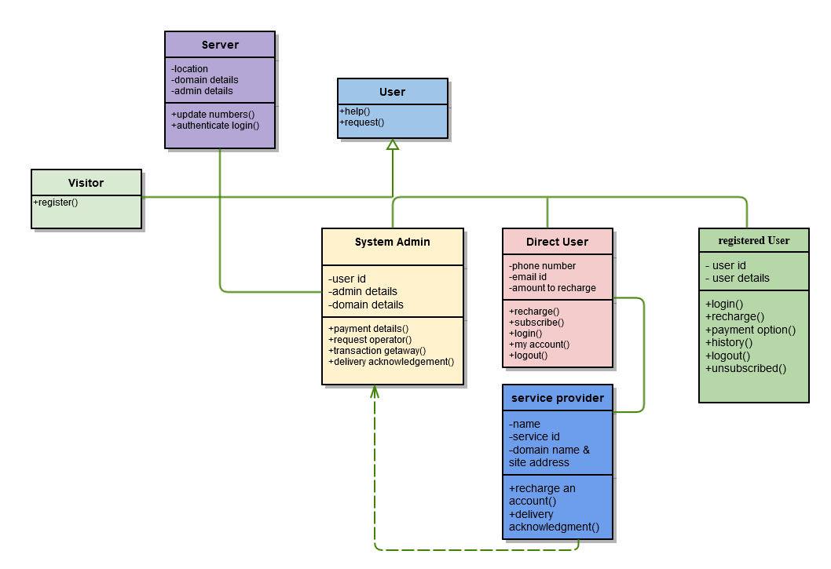
Sample diagrams
Class diagram mobile recharging

Slide 22
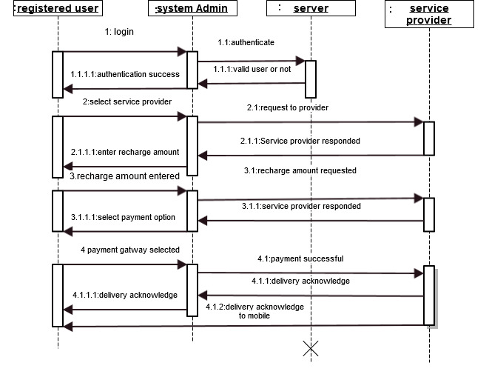
Sequence diagram

Slide 23
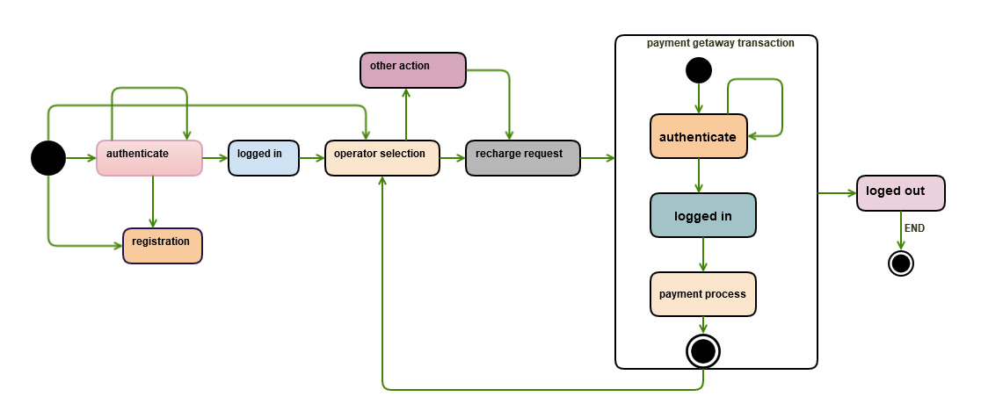
State chart diagram

Slide 24
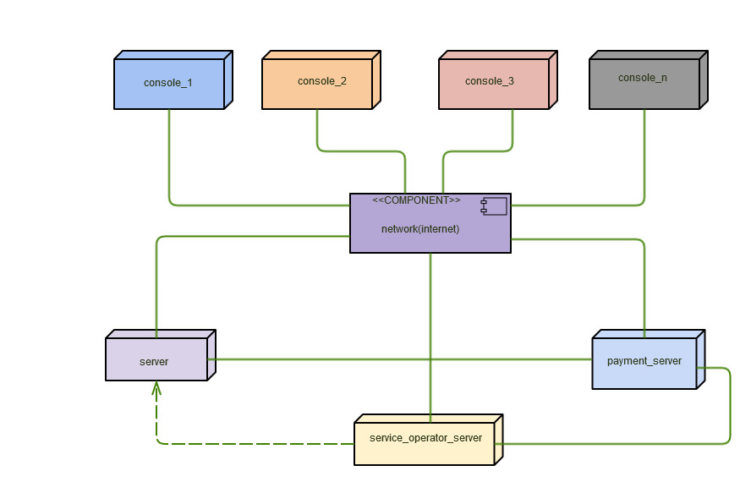
Deployment diagram

Slide 25
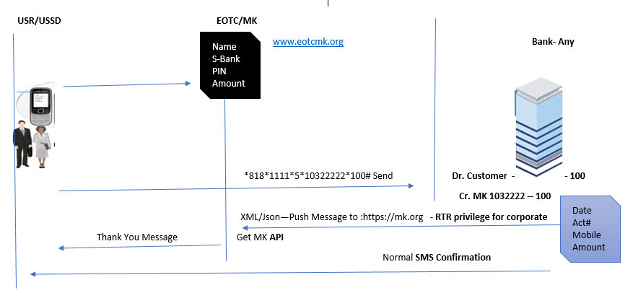

Slide 26
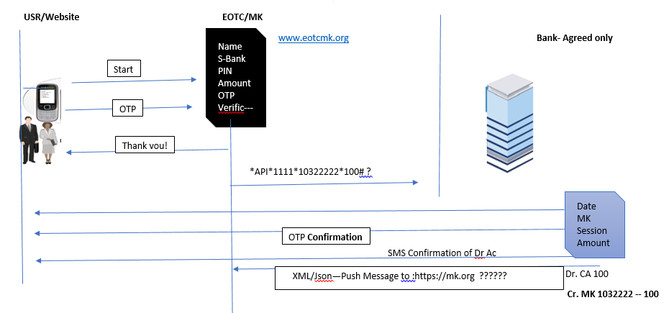

Slide 27
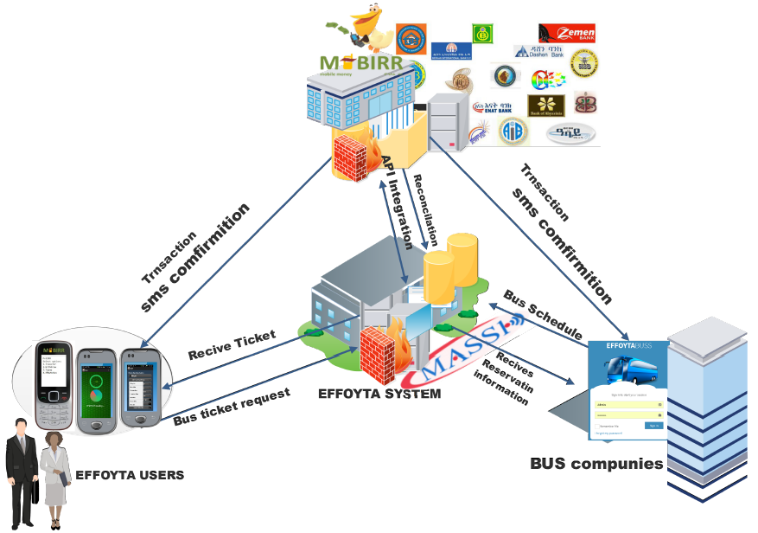
System Architecture
Rdt
*818#

Slide 28
THANK YOU!!!

